Slide 1
Hackademia Project
x86 emulator
2024-2025 Senior Design Project for:
Chloe Belletti, Preston Buterbaugh, Madilyn Coulson, Isabella Hall

Slide 2
Project Abstract
Our project is to develop a web module to display how C code translates to assembly code, and how x86 and x86 64-bit assembly code executes on a processor. The web app allows the user to enter C code, which it then dynamically compiles into the corresponding assembly code. The stack, registers, and other relevant elements of memory and processor storage will be displayed, and the user will be able to step through the assembly code and dynamically view how instructions update memory. If time permits, the app will also have a login ability to allow users the ability to save their personal snippets of C code, therefore allowing past entries to be retrieved.
Notes:
preston

Slide 3
User Stories
As a teacher, I want to create dynamic illustrations of how C code converts to assembly language, so I can easily and efficiently demonstrate re-creatable examples to my students.
As a teacher, I want to have a visual representation of how the execution of each line of assembly code affects the stack and registers in a computer, so my students can visualize low-level programming concepts.
As a teacher, I want to be able to save code snippets from previous C and assembly language demonstrations, so I can reuse them in future classes.
As a student, I want to get hands-on experience with compiling C code and viewing the conversion to assembly code, so I can better understand low-level coding concepts.
As a student, I want to create my own examples of C to assembly code and see its execution in progress, so I can enhance my learning outside of class.
As a student, I want to login to the Hackademia application, so I can view my past code entries to help with class assignments and studying.
Notes:
madi

Slide 4
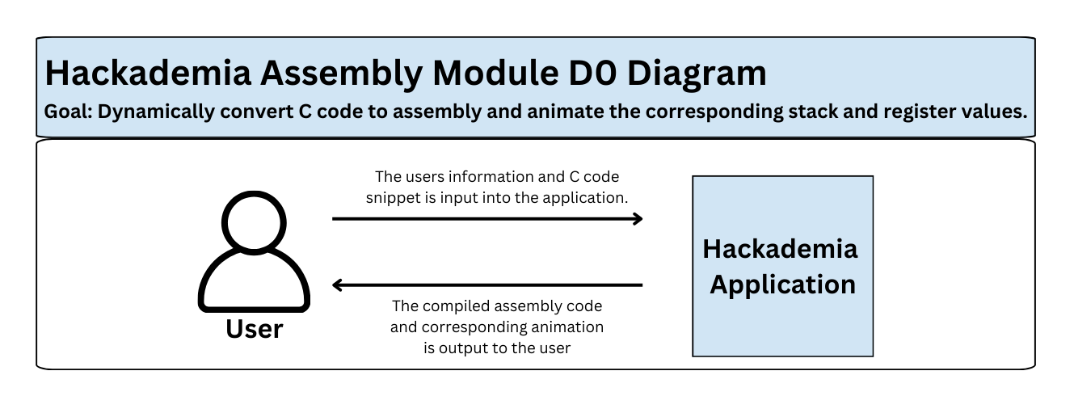
Design Diagrams: D0
Notes:
madi

Slide 5
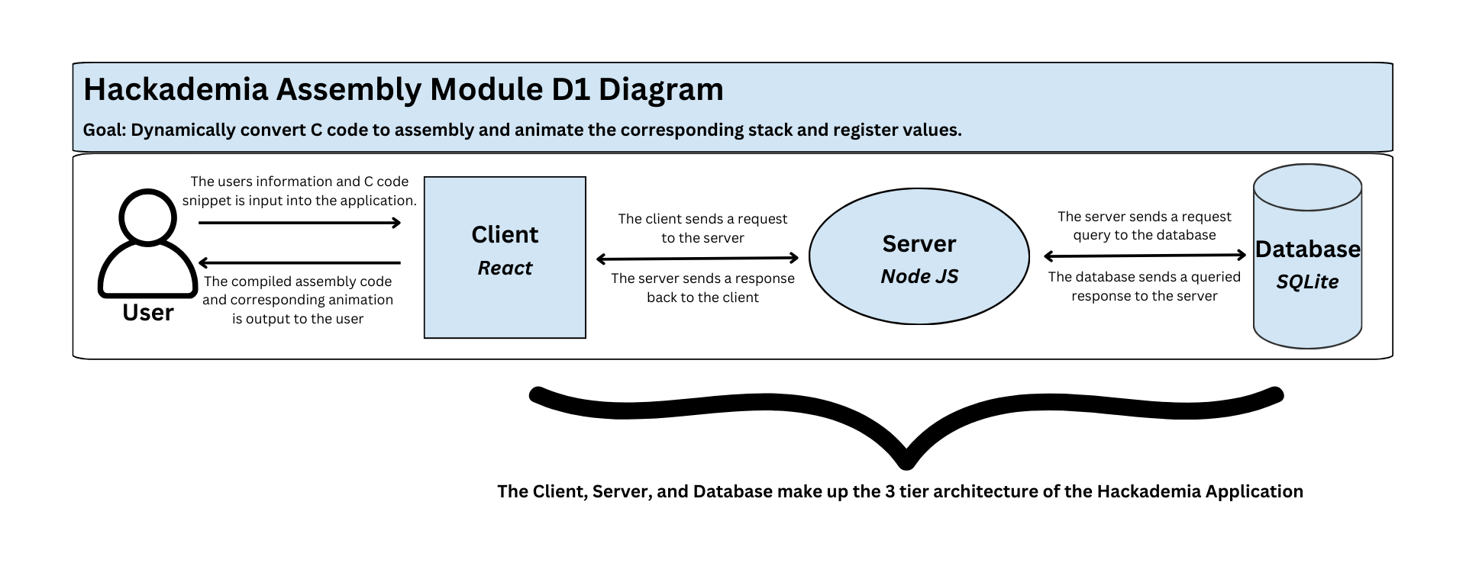
Design Diagrams: D1
Notes:
madi

Slide 6
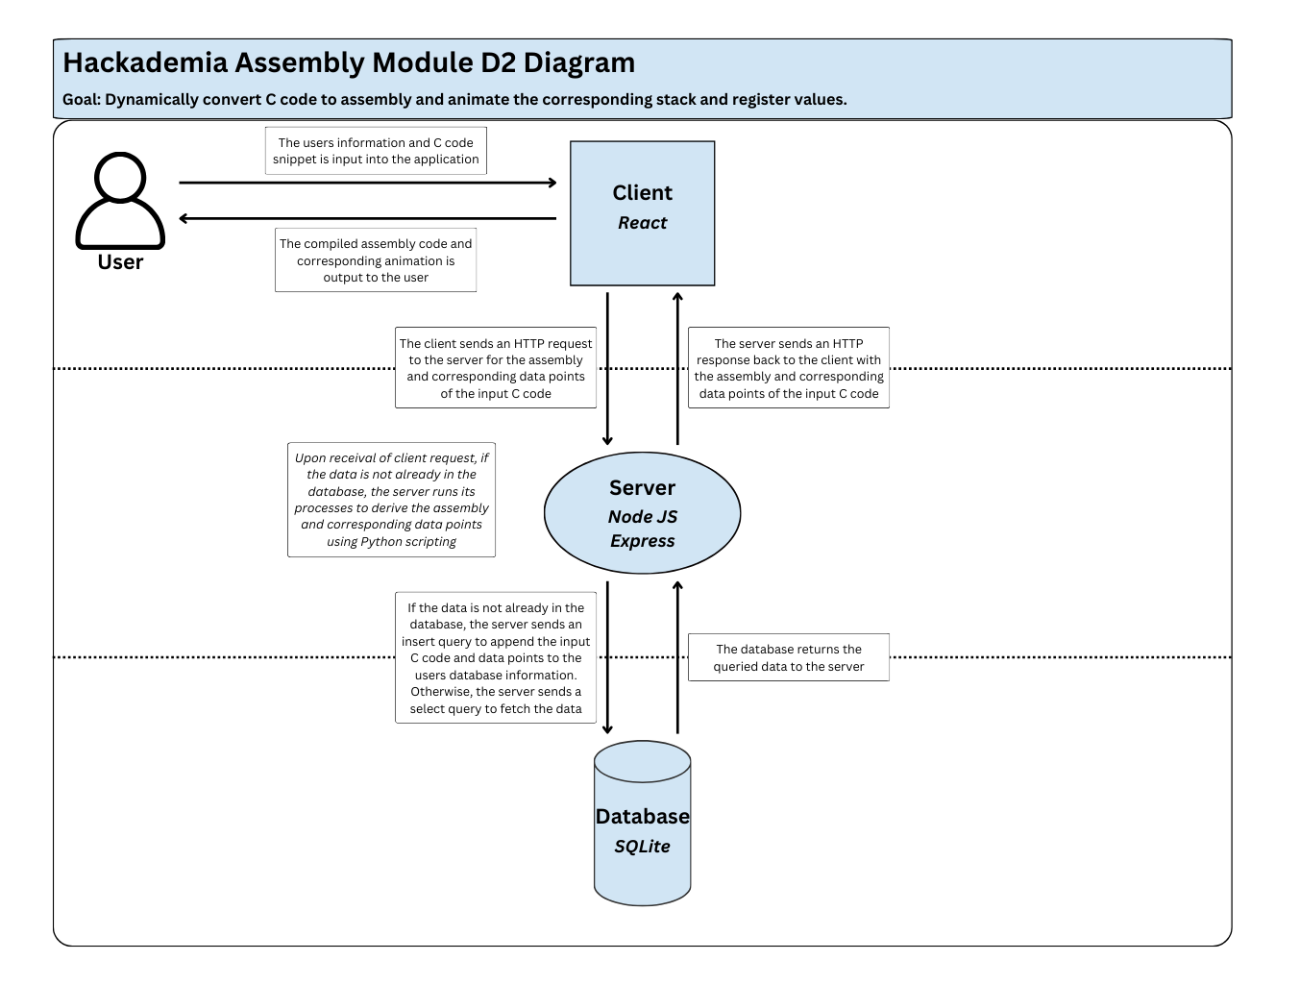
Design Diagrams: D2
Notes:
madi

Slide 7
Major Project Constraints
Security Constraints:
User data is available to any user who downloads the code to run it locally
Data leaks or misuse of personal information could be prevalent within the database
Social Constraints:
Users will need knowledge of how to set up and self host the server if it is not hosted publicly
Could cause issues for users who are beginners within programming and software, although the application is for those learning to program
Economic Constraints:
There is a cost for publicly hosting a server to run this application
However, without publicly hosting the site, this causes the first security constraint listed above
Notes:
chloe

Slide 8
Review of Project Progress
Established project goals and expectations with our advisor, Professor Giovani Abuaitah
Created a timeline that breaks down tasks and milestones
Researched the following areas:
GCC compilation of C to assembly code
Current server and client implementation
Database system options, including PostgreSQL and SQLite
Animation process for stack and register implementation
Updated client and server communication calls to Python Flask API
Developed a preliminary Python script to convert C code to AT&T x86 assembly
Notes:
chloe

Slide 9
Expected Accomplishments for End of This Term
Become familiar with current client/database/server implementation
Research server implementation language options
Research assembly code formatting in memory
Research GCC compilation process
Research Postgres or SQLite database design options
Develop basic server functionality
Develop preliminary Python script to convert C to assembly language
Notes:
izzy

Slide 10
Division of Work
Preston
Investigate/research current server implementation & server language options
Develop basic server communication functionality
Implement client process to send C code to server and receive assembly code
Madi
Research GCC compilation process
Design process to accept C code & output assembly & to receive C code, compile, send back assembly
Implement server process to receive C code & send assembly code to client
Chloe
Investigate current client implementation
Research assembly code formatting in memory
Design process to parse & interpret assembly
Experiment with & test UI design
Izzy
Investigate current database implementation
Research postgres database design options
Design, create, and test database
Research & design authentication system

Slide 11
Expected Demo at Expo
Open the Hackademia application, and login to a generic user profile.
Have a prepared example of C code, and insert this code to then dynamically compile to assembly.
Additionally, step through each assembly code example to show to animation and update of the stack and register components.
Save the prepared example entry after stepping through the code.
Within the generic user profile, display past inserted code entries and their output assembly, depicting the database component of the application.
These code examples should hold multiple programming concepts, such as strings, mathematical functionality, and loops.
Log out of the Hackademia application.
Notes:
izzy

Slide 12
Contact Info
Chloe Belletti
Email: belletce@mail.uc.edu
Preston Buterbaugh
Email: buterbps@mail.uc.edu
Project Advisor: Giovani Abuaitah
Email: abuaitgi@ucmail.uc.edu
Madilyn Coulson
Email: coulsomj@mail.uc.edu
Isabella Hall
Email: hallib@mail.uc.edu

